Slide 1

EXPOSYS DATA LABS INTERNSHIP
Domain : Web development
TITLE: Internship Registration Website

Slide 2
CONTENTS
Introduction
Contact page
Homepage
Form Submission
Registration form
Conclusion

Slide 3
Project Introduction
1
OPENING

Slide 4
OPENING
Brief Explanation:
Facilitate a seamless internship application process for both students and organizations.
Goals Mentioned:
Efficient Application Process
Domain-Specific Interest
Effective Communication
User-Friendly Interface
Organized Application Management
Enhanced Program Visibility

Slide 5
OVERVIEW OF
2
HOME PAGE

Slide 6
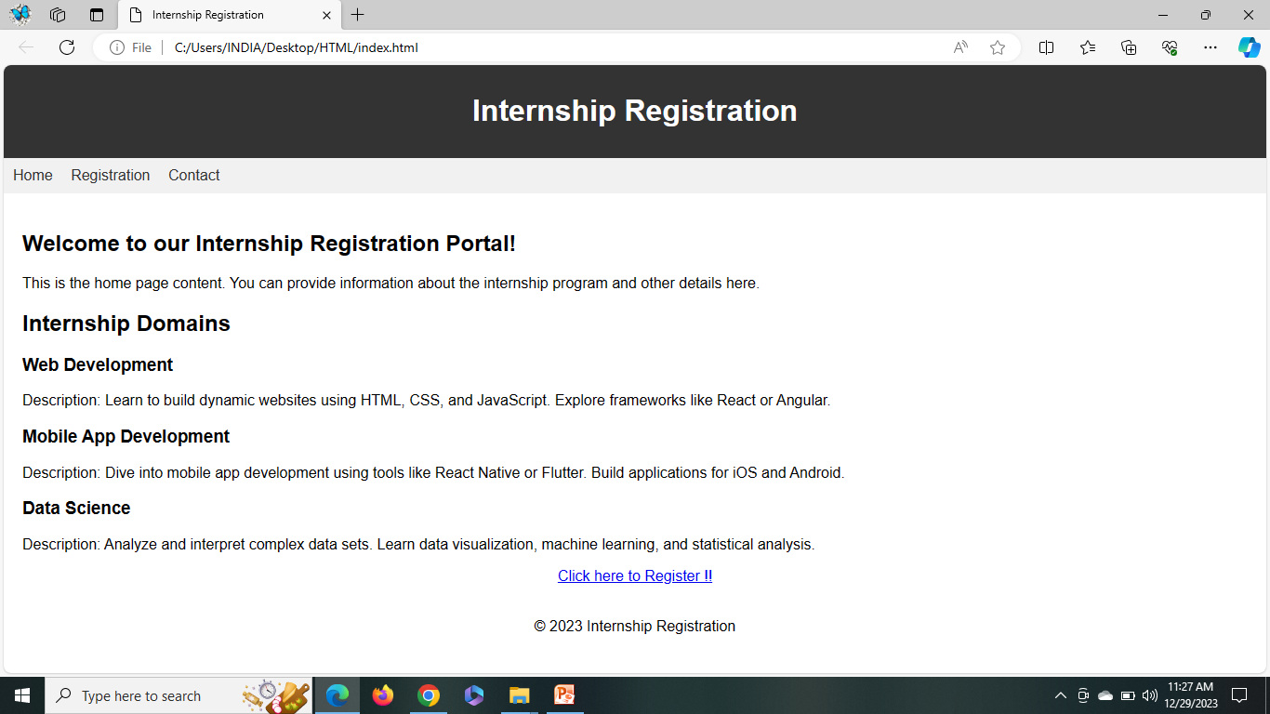
HOME PAGE
Welcome to the heart of our Internship Registration Website - the Home Page.
Key Features:
Internship Program Information:
Detailed insights into our dynamic internship program.
Objectives, benefits, and program highlights.
Available Domains:
Explore diverse internship domains tailored for growth.
Web Development, Mobile App Development, and Data Science.
User-friendly navigation for easy exploration.

Slide 7
WALKTHROUGH
3
REGISTRATION FORM

Slide 8
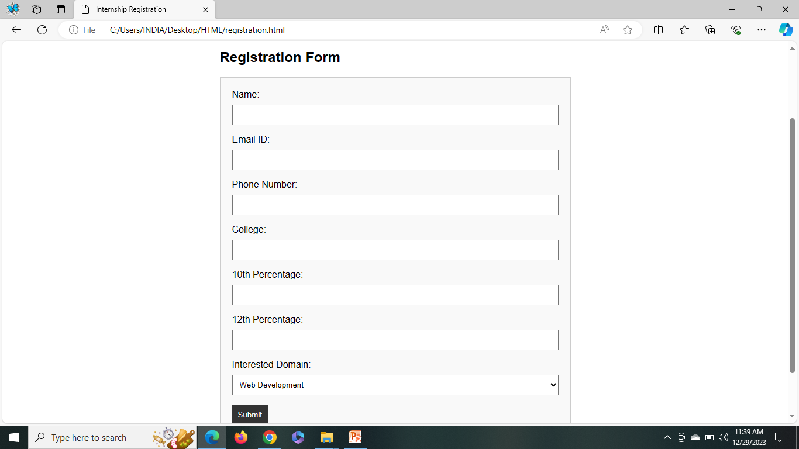
REGISTRATION FORM
Explore our user-friendly Registration Form, your gateway to exciting internship opportunities.
Sections:
Personal Information:
Name, Email, Phone, College.
Educational Information:
10th and 12th Percentage.
Domain Selection:
Dropdown for Web Development , Mobile App Development, and Data Science.
Submission Process:
Effortless submission with validation checks and a simulated success response.
User-Friendly Design:
Intuitive interface for a seamless application experience.

Slide 9
SHOWCASING
4
CONTACT PAGE

Slide 10
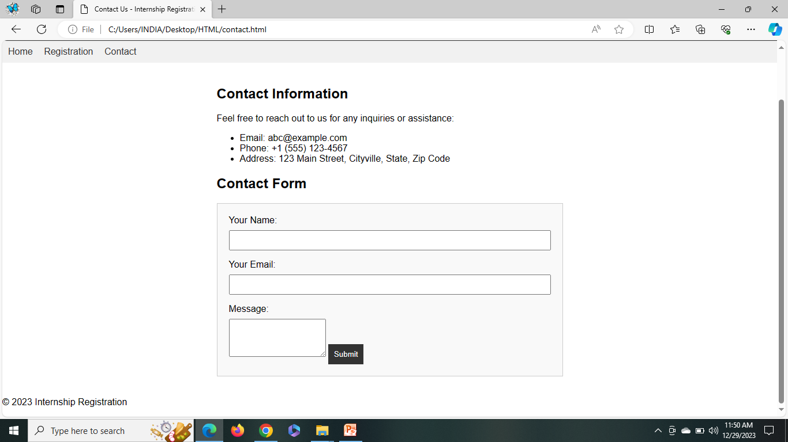
CONTACT PAGE
Connect with ease using our Contact Form designed for efficient communication.
Purpose:
Streamline inquiries, feedback, and communication between users and our team.
Fields:
Name: Enter your full name.
Email ID: Provide your email address.
Message: Share your inquiry or feedback.
How to Use:
Simple and straightforward process."
Fill in your details and message, then click 'Submit'.
Response Handling:
Upon submission, expect a prompt and helpful response from our team.

Slide 11
5
CONCLUSION

Slide 12
CONCLUSION
Thank you for exploring our Internship Registration Website.
Seamless registration, diverse domains, and user-friendly design await you.
Don't miss out on the opportunities – take the next step towards your career growth.
Call to Action:
Ready to dive in? Visit our website now: [file:///C:/Users/INDIA/Desktop/HTML/index.html]
Connect with us and experience a transformative internship journey!

Slide 13
THANK YOU !

